Slide 1

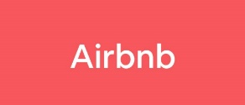
Final Project AIRBNB
CuriousIQ
Kateryna Andreieva

Slide 2

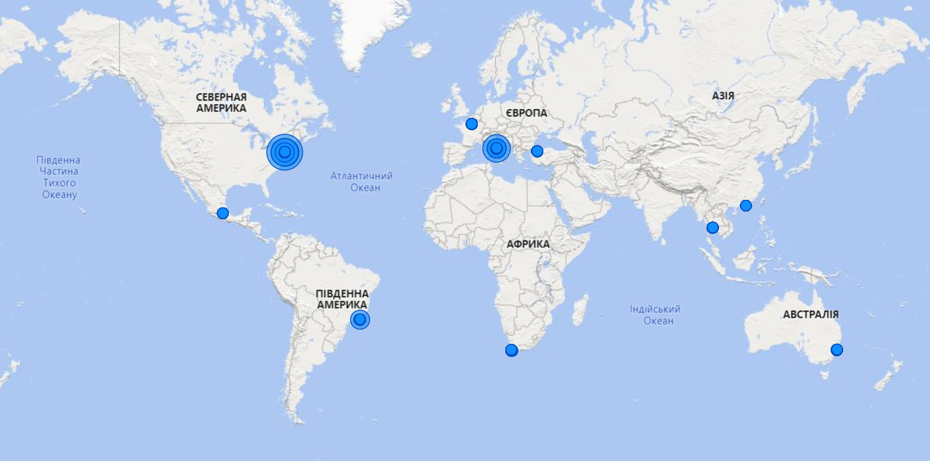
General
1000
Total Listings
The number of listings per Longitude and Latitude
82,50K
Total Reviews
21%
Instant Book
(Listings you can book without waiting for Host approval)

Slide 3

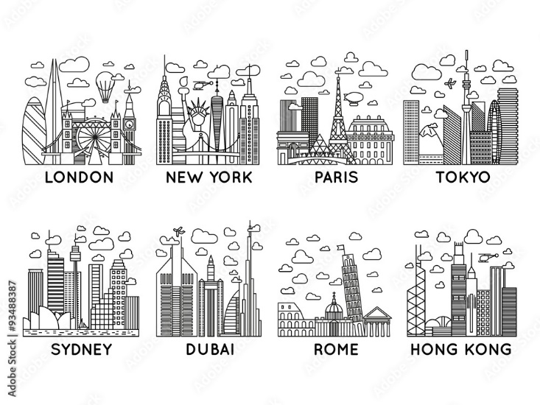
Listing
The number of listings per City
326
CITY | Number of listings
New York | 326
Paris | 211
Rome | 195
Rio de Janeiro | 83
Cape Town | 54
Istanbul | 49
Bangkok | 34
Sydney | 30
Mexico City | 11
Hong Kong | 7
1125
Maximum Nights
211
1
Minimum Nights
195

Slide 4

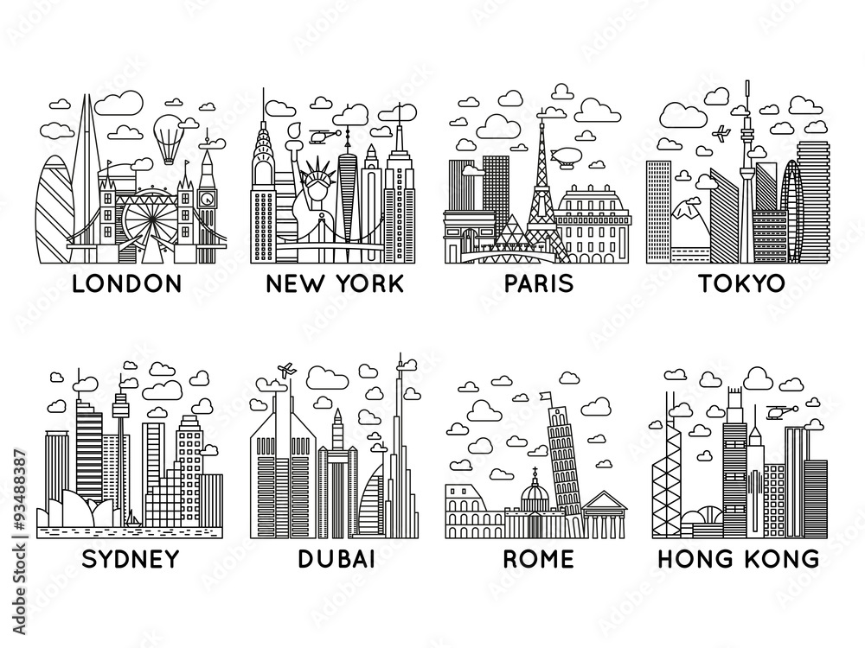
Property Type
55%
Entire apartment
(A place all to yourself)
68%
Listings with one bedroom
18,8%
Private room in apartment
(Your own room in a home or a hotel, plus some shared common spaces)

Slide 5

Prices
123 EUR
The average nightly price
141 EUR
The average listing price per night
108 EUR
656 EUR
The most expensive city is Sydney
(the biggest average listing price)
88
EUR

Slide 6

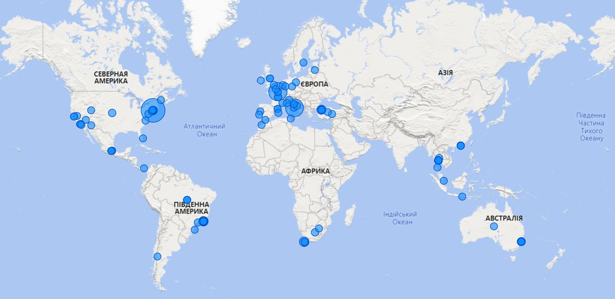
hosts
278
Super hosts
109
52
56
Count of listings by Host location

Slide 7


THANKS

